Slide 1
UNIT – II Mobile Telecommunications Systems

Slide 2
Introduction to 1G,2G,3G systems

Slide 3
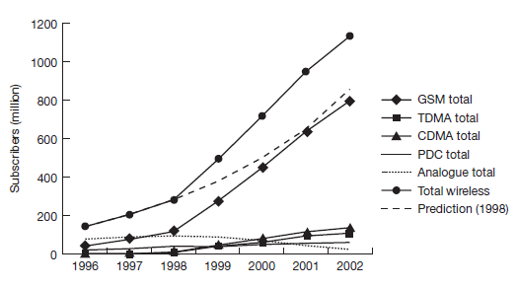
Worldwide subscribers of different mobile phone technologies

Slide 4
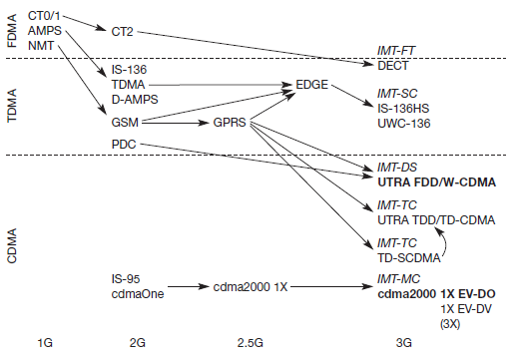
Development of different generations of mobile telecommunication systems

Slide 5
GSM

Slide 6
GSM Services
1. Bearer services
Transparent and non-transparent
Synchronous and asynchronous
2. Tele services
Telephony
SMS
MMS
EMS
Fax
3. Supplementary services
Call forwarding
Call diverting
encryption

Slide 7
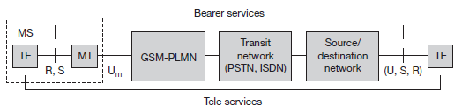
GSM Services (Contd…)
Bearer and tele services reference model

Slide 8
GSM – System Architecture

Slide 9
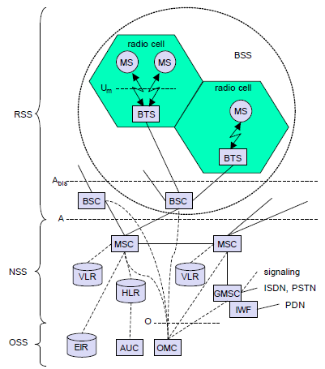
GSM Architecture
Complex system architecture with many entities, interfaces, acronyms
GMS consists of 3 subsystems
Radio subsystem(RSS)
Network and Switching Subsystem (NSS)
Operation Subsystem (OSS)

Slide 10
GSM Architecture (Contd…) 1. Radio Subsystem (RSS)
Comprises all radio specific entities ie
Mobile stations(MS)
Base station subsystem (BSS)
Connection between
RSS and NSS via A interface
NSS and OSS via O interface
Base Station Subsystem (BSS)
GSM has many BSS’s
Each BSS controlled by Base Station Controller (BSC)
BSS performs all functions necessary to maintain radio connections to MS, Coding/decoding of voice, Rate adaptation to/from wireless network

Slide 11
GSM Architecture (Contd…) 1. Radio Subsystem (RSS)
Base Transceiver Station (BTS)
BTS comprises all radio equipment i.e. antennas, signal processing, amplifiers necessary for radio transmission
BTS from radio cell using sectorized antennas
BTS connected to MS via Um interface
BTS connected to BSC via Abis interface
Base Station Controller (BSC)
BSC manages BTS’s
It reserves radio frequencies, handles handover from one BTS to another within BSS
BSC multiplexes radio channels onto fixed network connections at A interface

Slide 12
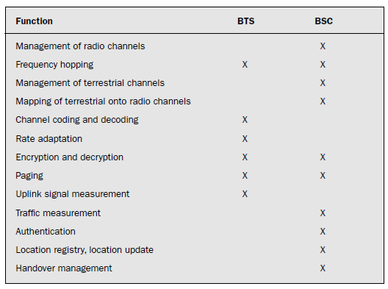
GSM Architecture (Contd…) 1. Radio Subsystem (RSS)
Tasks of BTS and BSC with in BSS

Slide 13
GSM Architecture (Contd…) 1. Radio Subsystem (RSS)
Mobile Station (MS)
Consists of all user equipment and software needed for communication with GSM network
MS consists of user independent hardware and software and Subscriber Identity module (SIM)
SIM stores all user-specific data that is relevant to GSM
MS can be identified via the international mobile equipment identity (IMEI)
User-specific mechanisms like charging and authentication are based on the SIM,
Device-specific mechanisms, e.g., theft protection use IMEI.
Without the SIM, only emergency calls are possible.

Slide 14
GSM Architecture (Contd…) 1. Radio Subsystem (RSS)
Mobile Station (MS)
The SIM card contains many identifiers and tables, such as
card-type,
Serial number,
a list of subscribed services,
a personal identity number (PIN),
A PIN unblocking key (PUK),
an authentication key Ki, and
the international mobile subscriber identity (IMSI)

Slide 15
GSM Architecture (Contd…) 1. Radio Subsystem (RSS)
Mobile Station (MS)
Using the wrong PIN three times will lock the SIM.
In such cases, the PUK is needed to unlock the SIM.
The MS stores dynamic information while logged onto the GSM system,
e.g., the cipher key Kc and the location information consisting of a temporary mobile subscriber identity (TMSI) and the location area identification (LAI)
Apart from the telephone interface, an MS can also offer other types of interfaces to users with display, loudspeaker, microphone, and programmable soft keys.

Slide 16
GSM Architecture (Contd…) 2. Network and Switching Subsystem (NSS)
Heart of GSM
NSS connects wireless network with public network
Performs handovers between different BSS
Comprises functions for
Worldwide localization of users
Support charging
Accounting
Roaming of users between providers
NSS consists of following switches and databases
Mobile Services Switching Center (MSC)
Home Location Register (HLR)
Visitor Location Register (VLR)

Slide 17
GSM Architecture (Contd…) 2. Network and Switching Subsystem (NSS)
Mobile Services Switching Center
MSCs are high-performance digital ISDN switches.
They set up connections to other MSCs and to the BSCs via the A interface
Form the fixed backbone network of a GSM system
A gateway MSC (GMSC) has additional connections to other fixed networks, such as PSTN and ISDN.
Using additional interworking functions (IWF), an MSC can also connect to public data networks (PDN)
An MSC handles all signaling needed for
connection setup,
connection release and
handover of connections to other MSCs

Slide 18
GSM Architecture (Contd…) 2. Network and Switching Subsystem (NSS)
2. Home Location Register (HLR)
Important Database in GSM
Stores user relevant information
Contains static information like
Mobile subscriber ISDN No. (MSISDN)
Subscribed Services (forwarding, roaming etc)
International Mobile Subscriber identity (IMSI)
Contains dynamic information like
Current Location Area (LA) of MS
Mobile Subscriber roaming No. (MSRN)
Current VLR & MSC
When MS leaves current LS, information in HLR is updated

Slide 19
GSM Architecture (Contd…) 2. Network and Switching Subsystem (NSS)
3. Visitor Location Register (VLR)
VLR associated to each MSC is dynamic database which stores all important information needed for MS users currently in LA
If new MS comes in LA, VLR is responsible for it, it has to store/copy relevant information from HLR

Slide 20
GSM Architecture (Contd…) 3. Operating Subsystem (OSS)
Contains necessary functions for network operation and maintenance
OSS has following entities
Operation and Maintenance Center (OMC)
Monitors and controls all other network entities via O interface
OMC functions are
Traffic monitoring
Status reports of network entities
Subscriber and security management
Accounting and billing

Slide 21
GSM Architecture (Contd…) 3. Operating Subsystem (OSS)
Authentication Center (AuC)
AuC is defined to protect user identity and data transmission
AuC consists of algorithms for authentication keys for encryption
Equipment Identify Register (EIR)
EIR is database for all IMEI’s
Stores all device identifications registered
If MS is stolen, any SIM can be use in MS
EIR has blacklist of stolen devices

Slide 22
Logical Channels of GSM
Traffic channels
Control channels

Slide 23
Traffic Channels (TCH)
GSM uses a TCH to transmit user data
Two basic categories of TCH
full-rate TCH (TCH/F)
half-rate TCH (TCH/H)
TCH/F data rate:- 22.8 kbit/s
TCH/H data rate:- 11.4 kbit/s

Slide 24
Control Channels (CCH)
Many different CCHs are used in a GSM
Broadcast control channel (BCCH)
Common control channel (CCCH)
Dedicated control channel (DCCH)

Slide 25
Control Channels (CCH) (Contd…)
Broadcast control channel (BCCH)
BTS use this channel to signal information to all MSs within a cell
The BTS sends information
For frequency correction via the frequency correction channel (FCCH)
About time synchronization via the synchronization channel (SCH)

Slide 26
Control Channels (CCH) (Contd…)
Common control channel (CCCH)
All information regarding connection setup between MS and BS is exchanged via the CCCH
BTS uses the paging channel (PCH) for paging the appropriate MS.
If an MS wants to set up a call, it uses the random access channel (RACH) to send data to the BTS.

Slide 27
Control Channels (CCH) (Contd…)
Dedicated control channel (DCCH)
As long as an MS has not established a TCH with the BTS, it uses the stand-alone dedicated control channel (SDCCH) with a low data rate (782 bit/s) for signaling.

Slide 28
GSM – Protocol Architecture

Slide 29
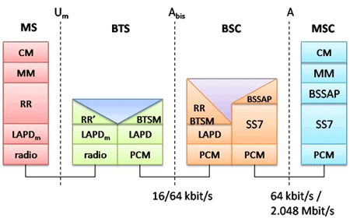
GSM Protocol Architecture

Slide 30
GSM Protocol Architecture (Contd…)
The physical layer, handles all radio-specific functions
Multiplexing,
synchronization with the BTS,
Detection of idle channels,
measurement of the channel quality on the downlink.

Slide 31
GSM Protocol Architecture (Contd…)
LAPDm protocol has been defined at the Um interface for layer two
LAPDm offers
reliable data transfer over connections,
re-sequencing of data frames, and
flow control

Slide 32
GSM Protocol Architecture (Contd…)
In Network Layer, lowest sublayer is the radio resource management (RR)
Only a part of this layer, RR’, is implemented in the BTS, the remainder is situated in the BSC.
The functions of RR’ are supported by the BSC via the BTS management (BTSM).
The main tasks of RR are
setup,
maintenance,
release of radio channels,
Directly accesses the physical layer
for radio information and
offers a reliable connection to the next higher layer

Slide 33
GSM Protocol Architecture (Contd…)
Mobility management (MM) contains functions for
registration,
authentication,
identification,
location updating,
provision of TMSI that replaces IMSI
MM offers a reliable connection to the next higher layer

Slide 34
GSM Protocol Architecture (Contd…)
Call management (CM) layer contains three entities:
call control (CC),
short message service (SMS),
supplementary service (SS).
CC provides a point-to-point connection between two terminals and is used by higher layers for call establishment, call clearing and change of call parameters.

Slide 35
GSM Protocol Architecture (Contd…)
Additional protocols are used at the Abis and A interfaces
Data transmission at the physical layer typically uses pulse code modulation (PCM) systems.
Signaling system No. 7 (SS7) is used for signaling between an MSC and a BSC. This protocol also transfers all management information between MSCs, HLR, VLRs, AuC, EIR, and OMC.
An MSC can also control a BSS via a BSS application part (BSSAP).

Slide 36
GSM – Frequency Allocation

Slide 37
Frequency Allocation in GSM
 | Uplink | Downlink
GSM 900 | 890-915 MHz | 935-960 MHz
GSM 1800 | 1710-1785 MHz | 1805-1880 MHz
GSM 1900 | 1850-1910 MHz | 1930-1990 MHz

Slide 38
GSM Routing

Slide 39
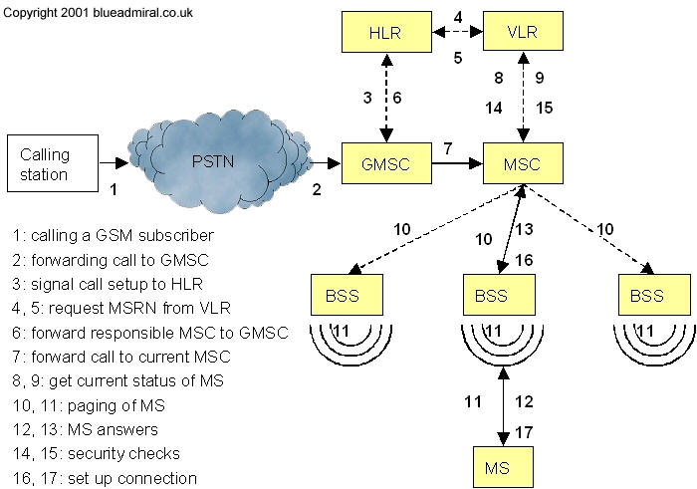
Mobile Terminated Call

Slide 40
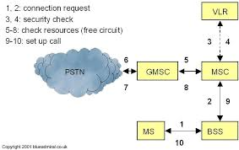
Mobile Originating Call

Slide 41
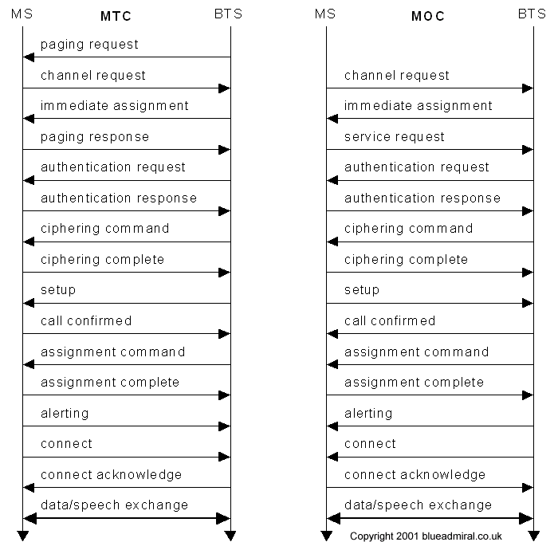
Message flow for MTC, MOC

Slide 42
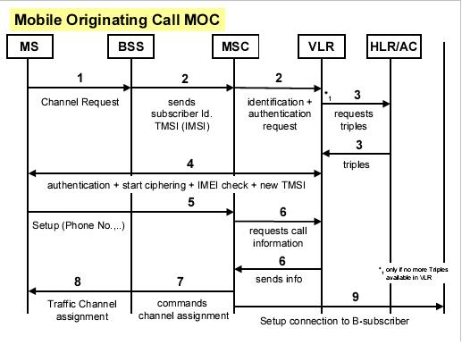
MOC

Slide 43
GSM Handover

Slide 44
GSM Handover Scenarios
Intra Cell
Inter-cell, Intra BSC
Inter BSC, Intra MSC
Inter MSC

Slide 45
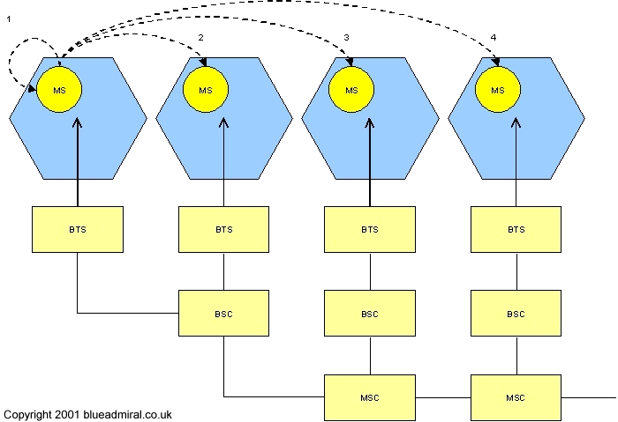
Handover Types

Slide 46
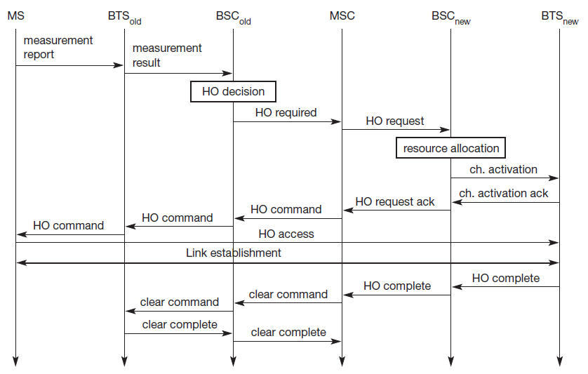
Intra-MSC

Slide 47
Security

Slide 48
Security Services by GSM
Access Control and Authentication
Confidentiality
Anonymity

Slide 49
3 Algorithms for Security Services
Algorithm A3 for authentication
A5 for Encryption
A8 for Generation of Cipher Key

Slide 50
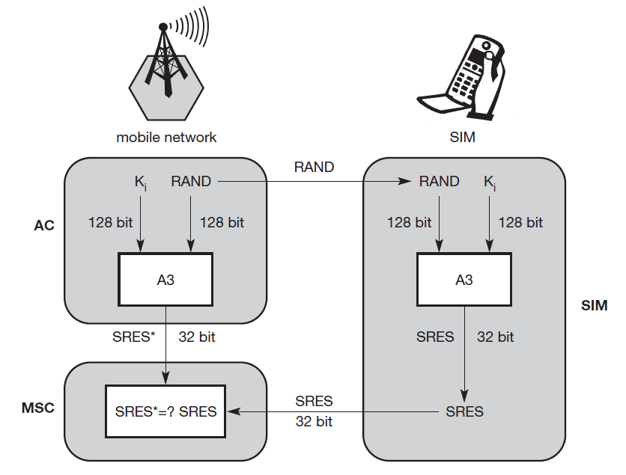
Authentication

Slide 51
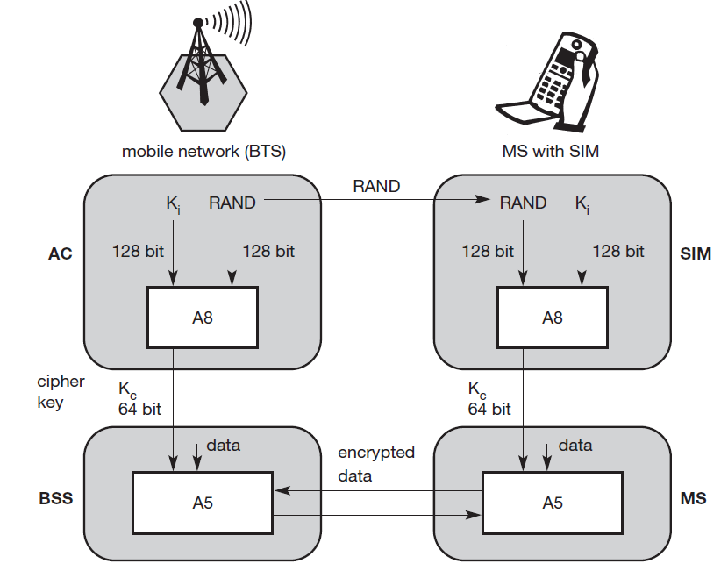
Encryption

Slide 52
GPRS

Slide 53
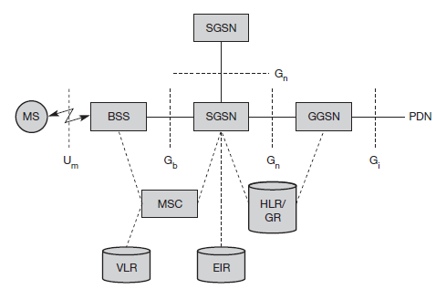
GPRS Architecture

Slide 54
UMTS

Slide 55
UMTS Architecture
Uu
Iu
UE
UTRAN
CN
UMTS: Universal Mobile Telecommunications System
UE: User Equipment
UTRAN: Universal Terrestrial Radio Access Network
CN: Core Network

Slide 56
UMTS Architecture
Uu
Iu
UE
UTRAN
CN
Inter system handover
Gateways to other networks
Location management
UTRAN
Cell level mobility
Contains radio network subsystem
Radio channel ciphering/deciphering
Handover control
Radio resource management

Slide 57
UMTS Domains and Interfaces
3
Core Domain
User Equipment Domain
Infrastructure Domain
1
2

Slide 58
UMTS Domains and Interfaces
USIM
Domain
Mobile Equipment
Domain
Core Domain
User Equipment Domain
Infrastructure Domain

Slide 59
UMTS Domains and Interfaces
It is End device
Functions for radio transmission
Encryption
Authentication
Stores user related data
USIM
Domain
Mobile Equipment
Domain
Core Domain
User Equipment Domain
Infrastructure Domain

Slide 60
UMTS Domains and Interfaces
USIM
Domain
Mobile Equipment
Domain
Access Network
Domain
Core Domain
User Equipment Domain
Infrastructure Domain

Slide 61
UMTS Domains and Interfaces
Contains radio access networks functions
Contains access network independent functions
USIM
Domain
Mobile Equipment
Domain
Access Network
Domain
Core Domain
User Equipment Domain
Infrastructure Domain

Slide 62
UMTS Domains and Interfaces
Home Network
Domain
USIM
Domain
Mobile Equipment
Domain
Access Network
Domain
Servicing Network
Domain
Transit Network
Domain
Core Domain
User Equipment Domain
Infrastructure Domain

Slide 63
Functions related to home network of user
When servicing N/w cannot contact home N/w
Functions currently used for accessing UMTS services
Home Network
Domain
USIM
Domain
Mobile Equipment
Domain
Access Network
Domain
Servicing Network
Domain
Transit Network
Domain
Core Domain
User Equipment Domain
Infrastructure Domain

Slide 64
UMTS Domains and Interfaces
Home Network
Domain
Uu
Zu
Cu
Iu
Yu
USIM
Domain
Mobile Equipment
Domain
Access Network
Domain
Servicing Network
Domain
Transit Network
Domain
Core Domain
User Equipment Domain
Infrastructure Domain

